Slide 1
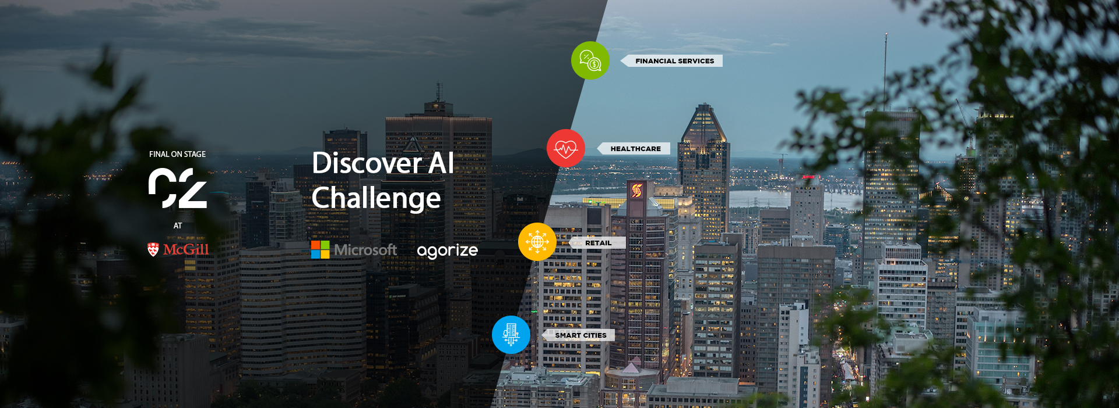
Garbage Collection Goes Smart (Greater Vancouver)
EGGCITED😋

Slide 2
PROBLEM STATEMENT
Problem Statement
How can the local government integrate waste collection into the smart city network?
Problems
Government is unable to effectively enforce waste disposal regulations;
Garbage collection inefficiencies: houses have different waste disposal patterns, so setting a fixed waste collection time for everyone brings in inconveniences for these households, and makes waste collection less efficient.
Opportunities
Supports more accurate tracking of incorrect waste disposal (“wrong waste in wrong bins”) and more effective penalization in that regard;
Allows lower waste processing costs by encouraging people to sort waste more accurately;
Improves convenience for households by developing customized waste collection schedule based on their waste disposal patterns;
Creates data inflow through internet of things that feeds into Greater Vancouver’s smart city network.
Notes:
what opportunities does this problem promise?

Slide 3
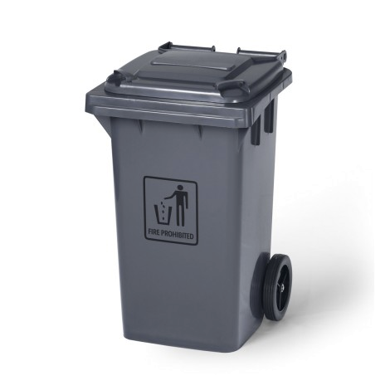
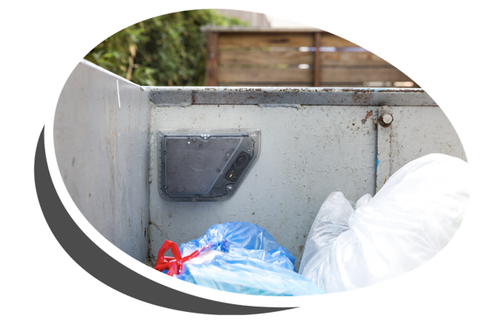
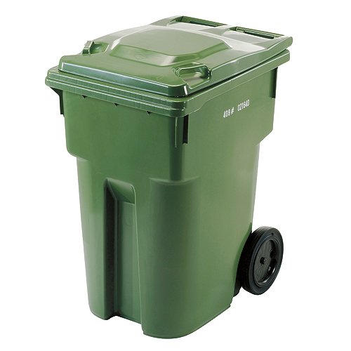
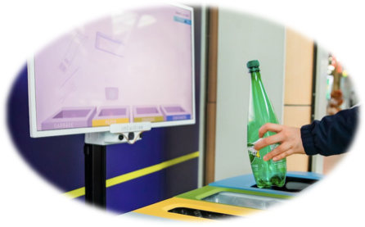
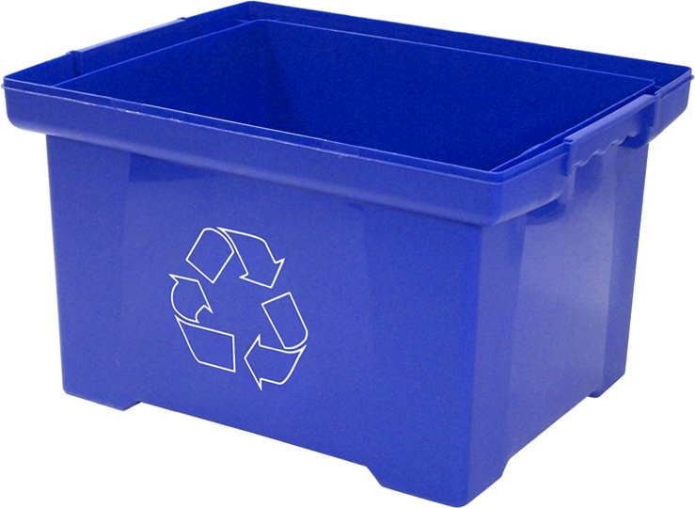
DESCRIPTION OF SOLUTION
Household garbage bins + Sensors + AI-powered cameras
=
The Garbage Collection Goes Smart (GCGS) System
Notes:
Image links:
(black garbage bin) https://www.johnnyvac.com/41333-large_default/grey-garbage-bin-on-wheels-100-l.jpg
(green garbage bin) https://encrypted-tbn0.gstatic.com/images?q=tbn%3AANd9GcQG3bwH4h3q2f2n0kdVTALpbI6mSBtufLWFPZxWVoFm7Zl3lrOm
(blue recycling bin) https://images-na.ssl-images-amazon.com/images/I/81BxwY-m0hL._AC_SL1500_.jpg
(sensor) https://recycle-smart.com/how-it-works/
(AI camera) https://images.dailyhive.com/20190506144342/oscar-vancouver-international-airport-recycle-bot-f.jpg

Slide 4
DESCRIPTION OF SOLUTION
Solution: The Garbage Collection Goes Smart (GCGS) System
Product Features: The GCGS system emcompasses three parts: household garbage bins, sensors, and AI-powered cameras supported by a cloud-base database.
The sensors will be assigned with unique IDs and installed inside household garbage bins to detect the fullness.
The AI-powered cameras will be installed inside the garbage collection trucks on both sides at the rear; they are to detect any objects violate the garbage sorting rules.
The cloud-base database will be used to collect and store relevant data for future pattern analysis and to support penalty enforcement regarding garbage sorting.
Similar solutions:
Oscar by Intuitive AI: “[An AI-powered smart trash bin that] eliminates contamination by identifying the object in your hand at the point of disposal and visually educates you on how to sort your trash.” (Intuitive AI, 2020)
RecycleSmart: Deploying smart containers and compactors to “monitor waste in real-time and plan optimal collection” for businesses. (RecycleSmart, 2020)
Product Differentiation Points:
The GCGS system is a governmental project with a residencial focus; due to its large targeting scale and privacy needs, none of the private organizations out there in the market would be able to achieve the same.
The sensors attached to the household garbage bins are designed to be directly linked to its geographical location instead of the house owners, hence there would be minimal privacy concerns about being exposed by one’s garbage.
The GSGC system would set the fundamentals for a larger smart city network; data coming from household garbage bins would support the design of more efficient waste collection schedule; in the future, it could be integrated into crime prevention and/or medical emergency networks.
Notes:
Reference:
(Oscar by Intuitive AI) https://intuitiveai.ca/
(RecycleSmart) https://recycle-smart.com/about-us/

Slide 5
TARGET
Sustainable city requires mutual efforts from both households and government. We want the GCGS system to be implemented in all households in greater Vancouver area to substitute the current garbage collecting system.
01
The city government of Greater Vancouver
Client
02
All households in the Greater Vancouver area
Size: >280,000 households
Target Audience
03
Average Household Size: 2.3
Average income level is 6.4% higher than the B.C. average
In 2015, median total income of households in Vancouver: $72,662
In 2016, the population of Greater Vancouver was 2.463 million
In 2016, the median age of Greater Vancouver was 28.7
Audience Characteristics
Notes:
Reference:
(Target Audience, Audience Characteristics) Canada Census :(https://www12.statcan.gc.ca/census-recensement/2016/dp-pd/prof/details/page.cfm?Lang=E&Geo1=CSD&Code1=5915020&Geo2=PR&Code2=59&SearchText=greater&SearchType=Begins&SearchPR=01&B1=All&TABID=1&type=0)

Slide 6
BUSINESS MODEL
Key Partners Government Technology suppliers Recycle companies Sensors companies (e.g. Oscar and RecycleSmart) AI developers | Key Activities Experiment in critical districts Install sensors in household trash bins Install sensors/cameras on garbage trucks | Value Proposition Clustering of households based on behavioral records Enforcement of recycle penalties Create a sustainable city Explore the patterns of waste disposal to enable further studies | Customer Relationships Frequent feedbacks from households to enhance continuous improvement | Customer Segments Segmenting households on a disposal habit basis(once a week, twice a week, once a month etc.) to ease waste collection
 | Key Resources Sensors AI-powered cameras and algorithm that detects and classifies garbage objects Data collected by the city of Vancouver |  | Channels Implement sensors on the bins beforehands and mail to houses
Cost Structures Expensive resources: cameras (for trucks), sensors (for bins) and cloud services (for database) Expensive activities: installation of sensors into households, data tracking and management, on-cloud data processing and storage |  |  | Revenue Streams This is a government project, so expected revenue stream would be government subsidies and research funds

Slide 7
SOLUTION’S ARCHITECTURE
Month#0
Step 0: Acquiring partners
The GCGS system will be mainly deploying existing technologies through partnerships with private organizations. Technologies we would be looking for includes:
Garbage bin sensors for households to detect the fullness of the bins; potential partners include (specialization in container sensors) Nordsense, SmartTrash, Enevo and (specialization in sensor deploying) RecycleSmart;
AI algorithm that identifies objects and classify them into garbage categories; potential partner includes Intuitive AI.
Month#8
Step 1: Technology development and adoption
Customize the acquired technologies to fit the government’s specific needs, such as smaller sensors to fit in household garbage bins;
Construct a cloud database to store and process information, such as sensor’s locations and garbage collected that violates the rules.
Month#14
Step 2: Pioneer test
Roll out the GCGS system in selected neighbourhoods (~5) to test its applicability, consistency and accuracy.
Month#20
Step 3: System improvement
Improve the GCGS system based on feedbacks from the pioneer test (both from technicians and households).
Month#23
Step 4: Beta test
Roll out the GCGS system on a larger scale, preferably covering an entire city (such as city of Richmond), to further test its stability and scalability.
Month#35
Step 5: Final adjustment and system release
Improve the GCGS system based on feedbacks from both the pioneer test and the beta test(both from technicians and households).
Roll out the GCGS system to all the cities in Greater Vancouver.

Slide 8
BENEFITS OF THE APPROACH
Households
Government
City
Help practice smart recycle in smaller households which is not served now
More customized waste collection schedule
Minimal privacy & compliance concern: The GCGS system can create a more sustainable environment without violating privacy
Better enforcement of recycle regulations, additional revenue and insights, cost-savings in recycle activities
Integrate data in a smart city system:
Crime detection/ prediction when more waste of harmful materials are found
Warning of elders in medical dangers when trash bin is not filled in a long time
Bring more accuracy to existing system by adding in more data
Reduced Waste
Better Recycle Program
Sustainable Development

Slide 9
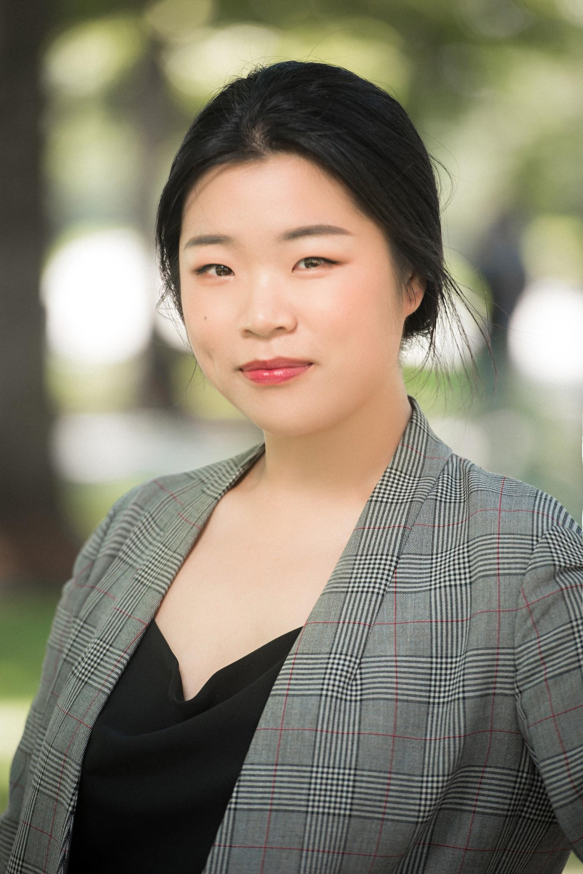
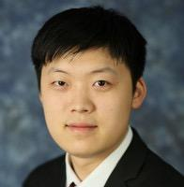
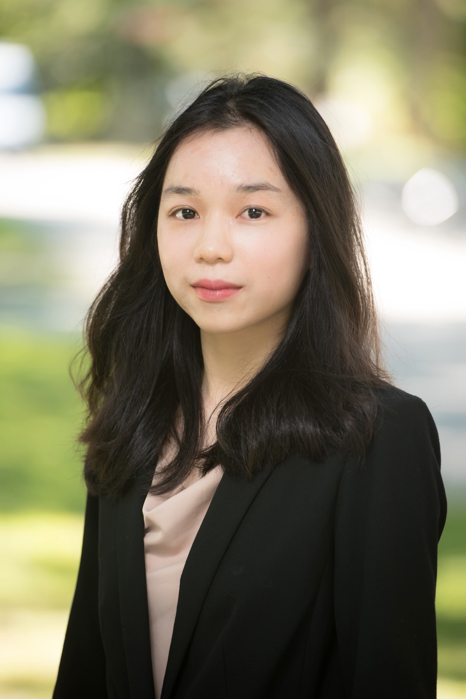
TEAM PRESENTATION
TAN
Qinyi(Claire)
23
Master of Business Analytics, UBC
Stay calm and debug.
☺
ZHENG
Hao
23
Master of Business Analytics, UBC
Stop daydreaming and use python to validate!
NGUYEN
Anh
22
Master of Business Analytics, UBC
k.

